Slide 1
Welcome!
Please, have a seat.
CWRU Quants
quants@case.edu
Notes:
Sources: https://github.com/CppCon/CppCon2017/blob/master/Presentations/When%20a%20Microsecond%20Is%20an%20Eternity/When%20a%20Microsecond%20Is%20an%20Eternity%20-%20Carl%20Cook%20-%20CppCon%202017.pdf https://blog.cloudflare.com/branch-predictor/

Slide 2
Agenda
Schedule for next few weeks
Changing Club Structure
Exec + Leadership
Project Groups
Notes:
Christo

Slide 3
Schedule
Spring 2025
Summer 2025
Fall + Spring 2026
End of semester Project Showcase
Paper writing
more food
Notes:
Christo

Slide 4
Schedule
Spring 2025
Summer 2025
Fall + Spring 2026
Continue working on projects, weekly remote meetings
If you don’t have anything to work on this summer, THIS IS YOUR OPPORTUNITY
(Research) We will be working alongside Professor Bae this summer, so you will be able to work on a project this summer while building strong relationship with our Professor
Study for recruiting season (Leetcode, system design)
(Exec and Leadership) Plan for the fall semester
Notes:
Christo

Slide 5
Schedule
Spring 2025
Summer 2025
Fall + Spring 2026
Start off the year strong, recruit strong talent
Emphasis on mentorship, community, support
Continue working with KeyBank, we have case studies planned with Matt (Senior Quant)
Continue Projects, more food catering, more fun stuff
Notes:
Christo

Slide 6
Changing Club Structure
Types of members:
GB member (no project)
Vertical member (research, trading, education, dev)
Exec or Leadership
Application for Verticals
Why?
Select people who are intellectually curious, want to be part of supportive community, and want to learn and work on interesting stuff
Want to create culture of mentorship within the club
Vertical projects are getting more technically complex, need to recruit the right people for the job
More expected commitment from members
Notes:
Christo

Slide 7
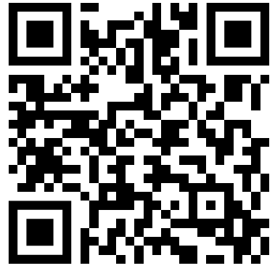
Exec + Leadership
Please submit a response to this (brief!) application
We’ll have a 1-round interview stage for selected candidates
You’ll be notified of a decision shortly after that!
Notes:
Christo

Slide 8
The Development Vertical
Quant developers, in general, develop software tools to facilitate research and trading. Examples include low-latency trading systems and data visualization software.
The Development vertical at CWRU Quants will work on a comprehensive backtesting framework that the Research and Trading verticals will use to backtest their strategies.
We currently have a working product! You can install it on your machine right now! pip install -i https://test.pypi.org/simple/ cwrubacktest
It currently has:
improved and more modular rebalancing logic
more customization over fee model in the simulation
more realistic trade execution logic
over the main open-source backtesting frameworks!
We need developers to work on:
better performance statistics and plotting
support for more strategies and signals
a test suite
and more
Notes:
Ray

Slide 9
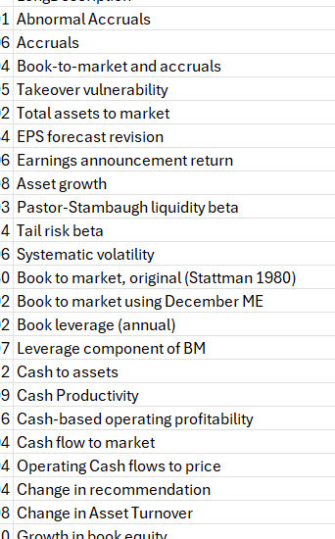
The Trading Vertical
Have large number (212 ) of already-established predictive signals
We also have the monthly returns, volume, shares outstanding, etc. of many stocks
Together, we will investigate what signals are the most effective (and in which industries too)
Currently working on methodology and framework
Later, just plug-in different inputs and see what works best
Notes:
Christo

Slide 10
The Research Vertical
We are currently doing sentiment and semantic analysis on earnings transcripts, and hope to mine a large feature set to eventually train various ML algorithms on this fall semester
We work mainly in python, and do a lot of paper reading to understand where the level of academia is at, and what we can do to continue building out our features
Timeline
Spring25: Build out feature set
Summer25: Build out feature set + add labels
Fall25: Algorithm development
Notes:
Ethan
I think you guys should also look to develop some proprietary signals (to compare how good the ones we make are against the ones in the paper)
This can be a large portion if you need to be^
For example, scrape the linkedin posts of company management to get some signal
Or…get some sources of alternative data (like company management private jet logs) and see if there is any relation to company disclosures, stock price, etc.

Slide 11
The Education Vertical
Continue working on our volatility project, which we will deliver in a few weeks
Notes:
Ethan
I think you guys should also look to develop some proprietary signals (to compare how good the ones we make are against the ones in the paper)
This can be a large portion if you need to be^
For example, scrape the linkedin posts of company management to get some signal
Or…get some sources of alternative data (like company management private jet logs) and see if there is any relation to company disclosures, stock price, etc.

Slide 12
QUESTIONS AND ANSWERS
Contact us!
Email: quants@case.edu
Instagram: @cwruquants

